Slide 1
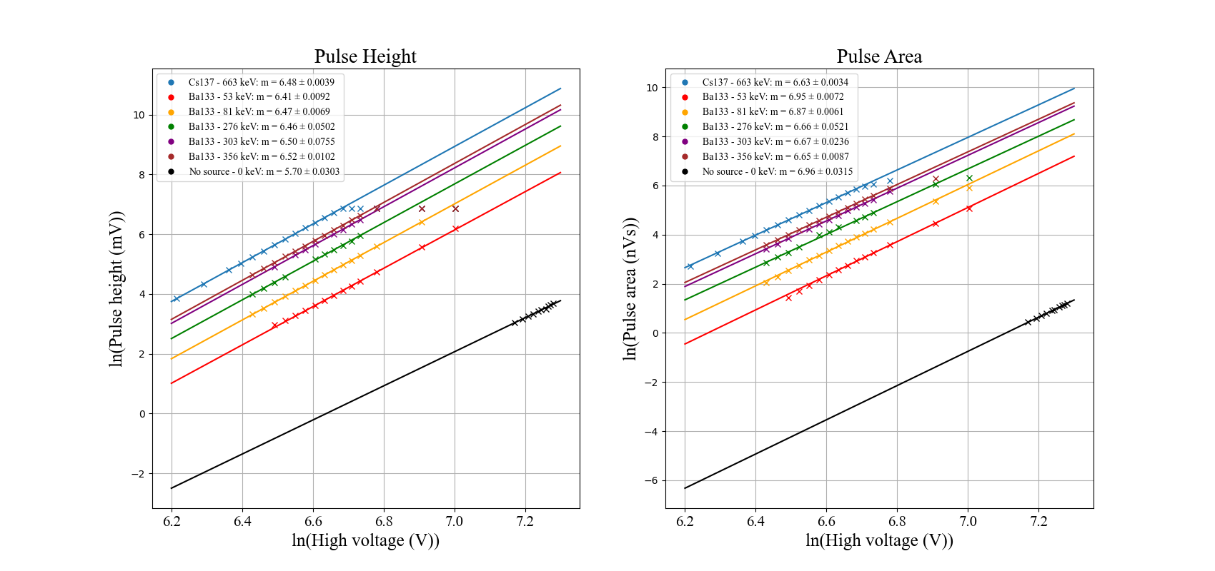
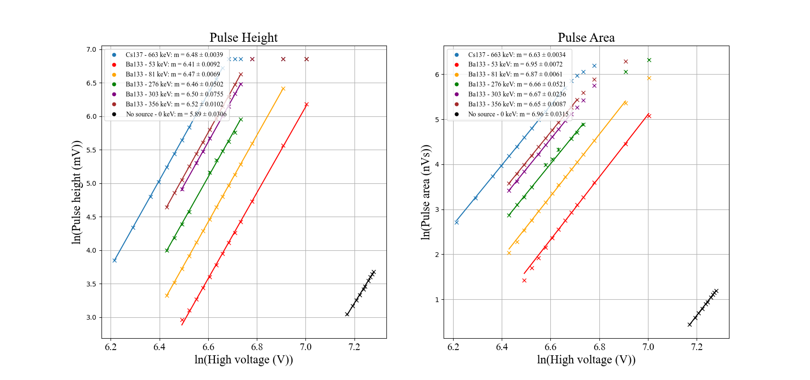
Fitting gain (μ) as a function of high voltage (V):
μ = AV^{b}
Ln(μ) = bln(V) + ln(A)

Slide 2
Fitting gain (μ) as a function of high voltage (V):
μ = AV^{b}
Ln(μ) = bln(V) + ln(A)

